Slide 1
Reinventing the Rule of Law
Bart van der Sloot

Slide 2
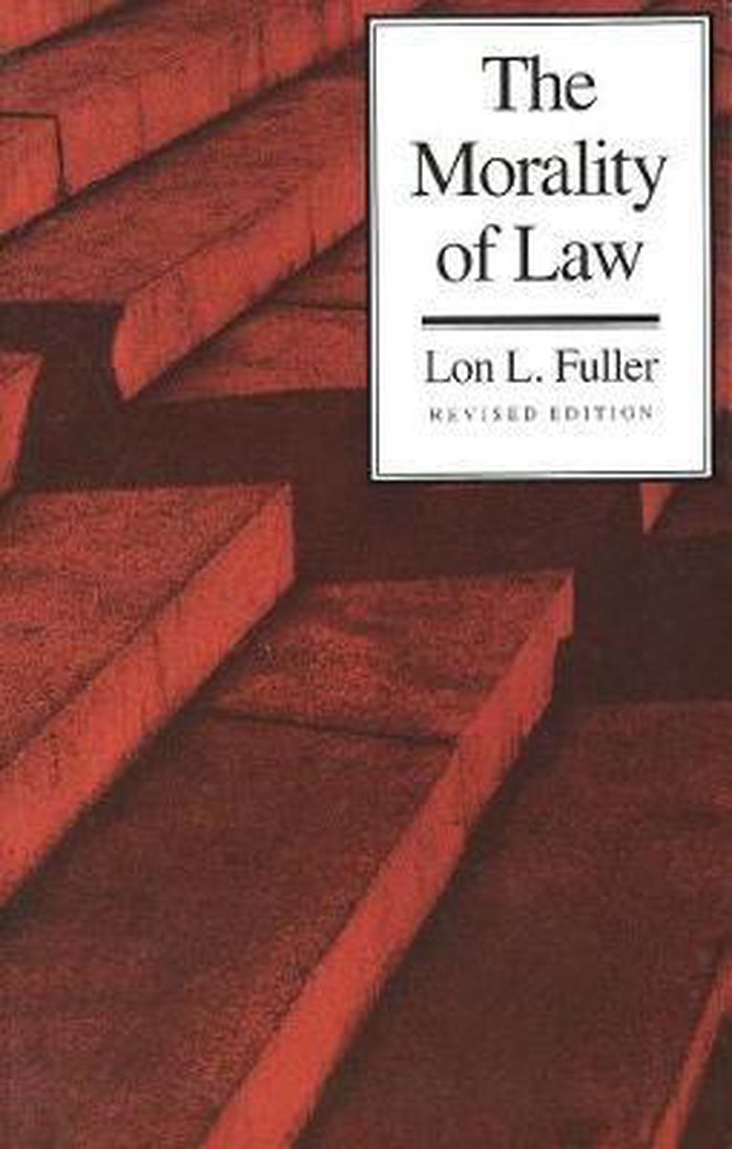
Totalitarian regimes mostly pretend to be democracies (e.g. Democratic People's Republic of Korea)
Totalitarian regimes mostly pretend to respect the rule of law (e.g. Russia, Nazi regime)
Totalitarian regimes (ab)use democracy and the rule of law to their advantage
Can we distinguish between law in name only and law proper?

Slide 3
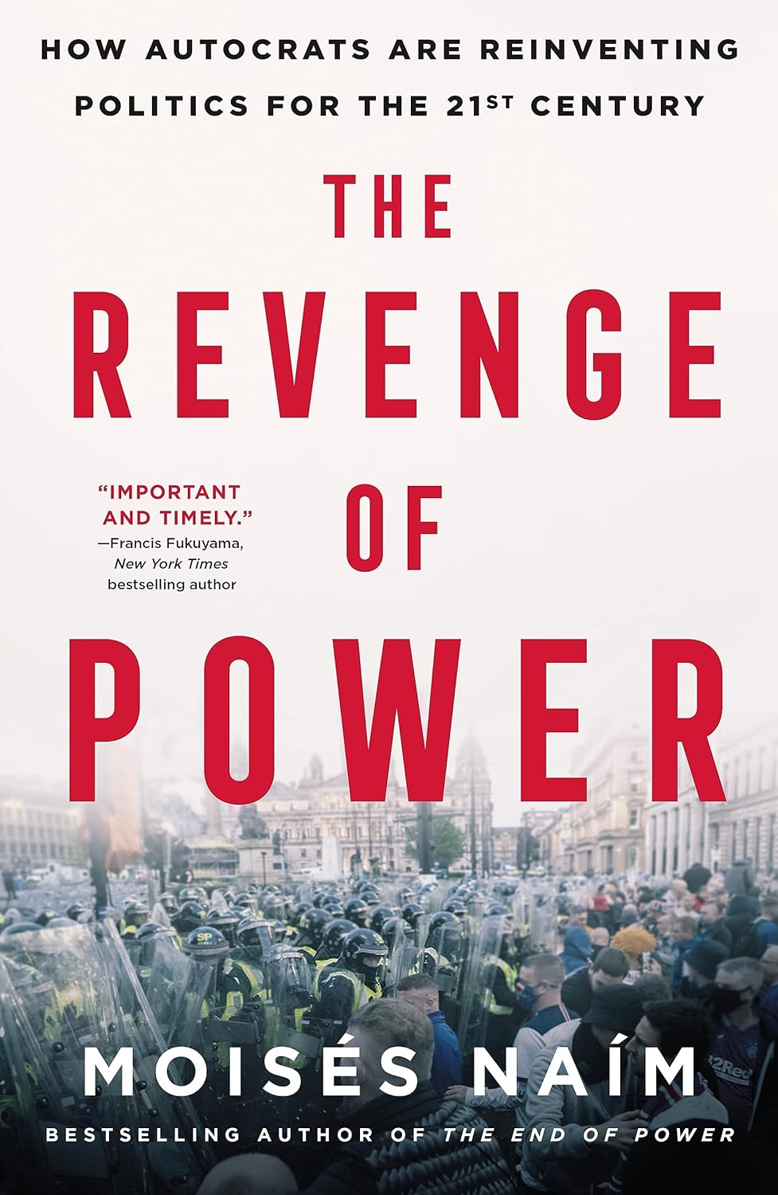
‘Pseudolaw should be seen as an instrument of post-truth’
Pseudo-separation of power
Pseudo-referenda
Gerrymandering – voter/voting requirements
Pseudo state of emergency

Slide 4
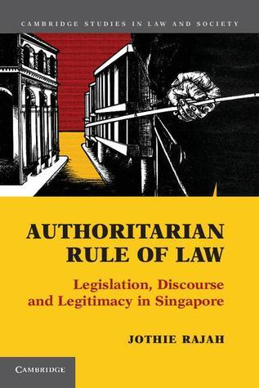
Distinguish Rule of law and Rule by Law
Defamation law, use it to muffle the press
Public order and other vague terms, use margin of discretion
Pressure the bar association to expel certain members

Slide 7
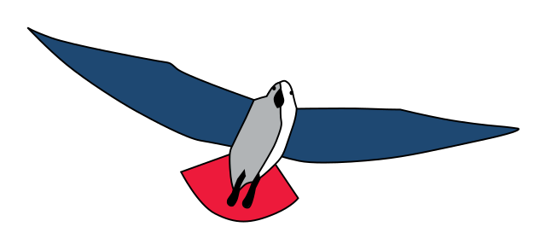

Slide 8
What about the rule by law in western democracies?
Media
Use normal discretion executive power to appoint friends of the regime in high places
Have friends buy up media organizations and then use the rule of law argument not to intervene.
Not give access to press conferences/documents to critical press
Use defamation law to prosecute critical journalists

Slide 9
What about the rule by law in western democracies?
Media themselves
Infuse polarisation in society/speak ill of political opponents
Stigmatise marginalised groups in society under the guise of freedom of speech
Post-truth (eg fox news in Dominion)

Slide 10
What about the rule by law in western democracies?
Elections
Use normal discretion executive power to choose the ‘right’ moment to hold elections
Use normal discretion executive power to give benefits to people just before election day
Use normal discretion to create media incident just before election day (eg NL ousting Turkish politician)
Gerrymandering – dissuading people from voting

Slide 11
What about the rule by law in western democracies?
Elections
Exclude political enemies from participating with ulterior argument (eg they did fill in their tax form correctly)
Starting legal investigations into donors of political enemies
Use referenda/democracy to undermine the rule of law, eg rights of minorities
Set up strawman parties to have mock political debates

Slide 12
What about the rule by law in western democracies?
Laws
Use vague concepts (eg foreign agents, enemy of the people, people with terrorist intend) that can be interpreted at will
Give large powers to executive power without proper checks and balances (mass surveillance laws)
Use normal discretion to create media incident just before election day (eg NL ousting Turkish politician)
Use parliamentary immunity for post-truth, defamation, polarisation, criticising judges, etc. Dogwhistles.
Use vague concepts (eg foreign agents, enemy of the poeple, terrorist) that can be interpreted at will
Abuse the state of emergency to enlarge powers/to curtail rights of the judiciary/parliament

Slide 13
What about the rule by law in western democracies?
Judiciary
Use normal discretion to appoint regime-friendly judges
Set seemingly neutral requirements (eg age) for judges
Judges that take laws literary, but contrary to the spirig
Judges that make use of the vague concepts in law/margin of appreciation to favour regime/disadvantage political opponents
Judgments that contain virtually no argumentation

Slide 14
What about the rule by law in western democracies?
Privatisation
Privatise law enforcement tasks to have private parties/citizens do what public authorities cannot do
Privatise public tasks (eg education, health, media) to avoid positive obligations and democratic oversight
Use foreign investments to favour certain parties, eg in religious institutions, schools, media or political parties

Slide 15
What about the rule by law in western democracies?
Executive power
Use margin of appreciation for arbitrary use of power
Ignore judicial verdicts (eg by ECtHR)
Ignore factual information in favour of political momentum
Use executive privileges not for general interest but for political party interests
Use international obligations to hide behind
Use bureaucratic/legal jargon so no it becomes difficult to challgence
Ignore feedback from advisory bodies

Slide 16
What about the rule by law in western democracies?
Citizens
Allow for vigilantes
Do away with legal aid/assistance so that people are on their own against the system
Make law only about private interests/ensure that groups cannot complain nor invoke the general interest
Create confusion and political apathy with voters
Use newspeak to confuse citizens
Illtreat whistleblowers

Slide 17
Response by CoE and EU
CoE
Reinvention of Article 18 ECHR
Greater importance of Article 17 ECHR
Quality of law/legislative debate/decision-making process
Positive obligation to counter polarisation
Pilot judgements

Slide 18
Response by CoE and EU
EU
DSA & Code of Practice on Disinformation
Defence of Democracy Package (Directive on Transparency of Interest Representation on behalf of Third Countries)
DIRECTIVE OF THE EUROPEAN PARLIAMENT AND OF THE COUNCIL on protecting persons who engage in public participation from manifestly unfounded or abusive court proceedings (“Strategic lawsuits against public participation”)
Actions against Hungary and Poland

Slide 19
Draft overview of the study
1. Introduction
2. Overview examples rule by law
3. Theory democratic rule of law
4. Effects of rule by law
5. Reinterpreting the rule of law
6. Conclusion

